Slide 1

Chapter 7
Transmission Media

Slide 2
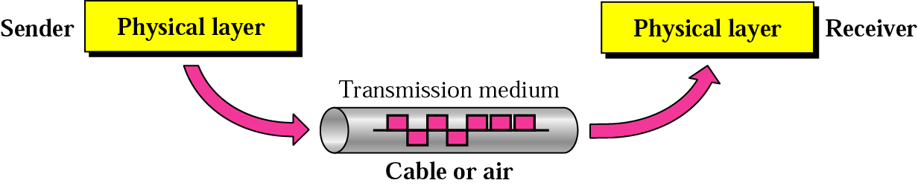
7. Transmission media
Transmission medium and physical layer

Slide 3
Transmission media
7.1 Guided Media
7.2 Unguided media: Wireless

Slide 4

Transmission Media(cont’d)
Classes of transmission media

Slide 5
7-1 GUIDED MEDIA
Guided media, which are those that provide a conduit from one device to another, include twisted-pair cable, coaxial cable, and fiber-optic cable.
Topics discussed in this section:
Twisted-Pair Cable
Coaxial Cable
Fiber-Optic Cable

Slide 6

Twisted-Pair Cable
Figure 7.3 Twisted-pair cable
Two copper conductors
One carriers signals, the other is the ground reference
Receiver operates on the difference between the signals.
This is why they are twisted, to maintain balance
More twists mean better quality

Slide 7
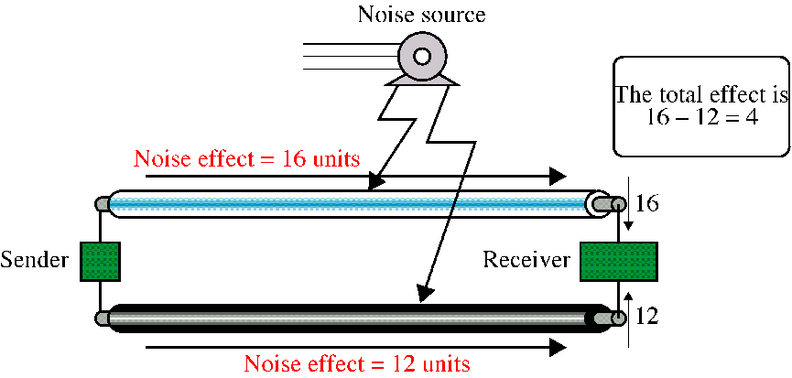
Twisted-Pair Cable
Effect of noise on parallel lines

Slide 8
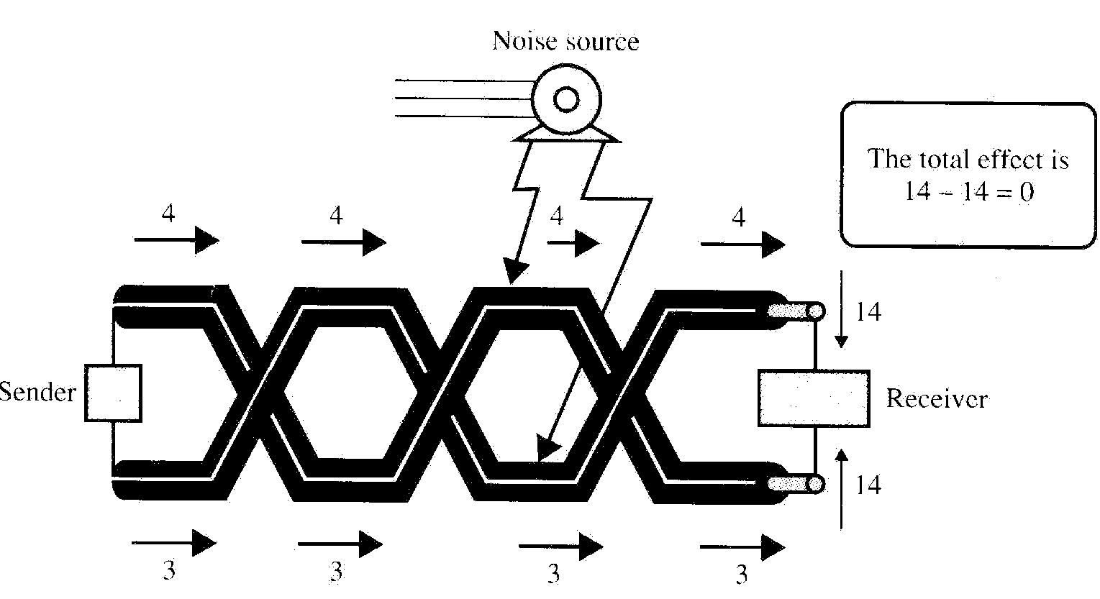
Twisted-Pair Cable
Effect of noise on twisted-pair lines

Slide 9

Twisted-Pair Cable
Twisted-Pair Cable comes in two forms
  - Unshielded twisted pair cable
  - Shielded twisted pair cable

Slide 10
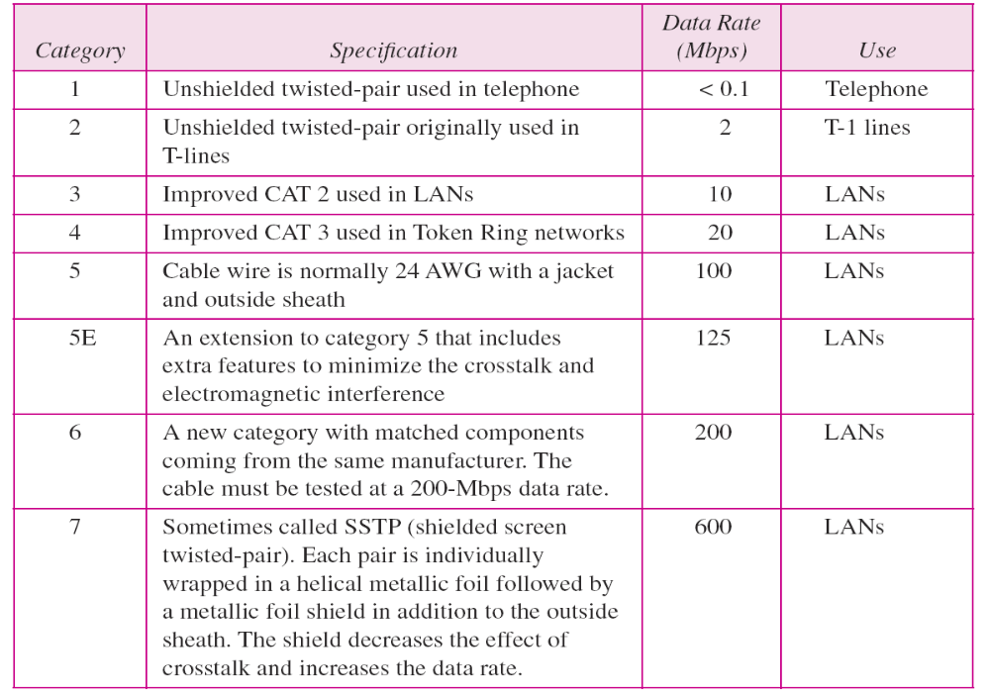
Table 7.1 Categories of unshielded twisted-pair cables

Slide 11
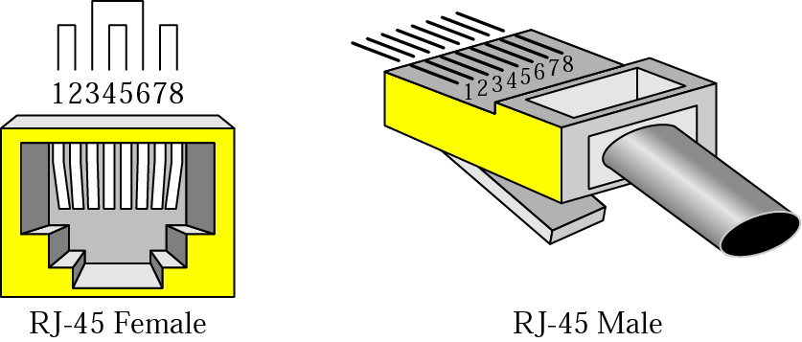
Twisted-Pair Cable
UTP connectors
RJ – Registered Jack
keyed connector, can be inserted one way

Slide 12
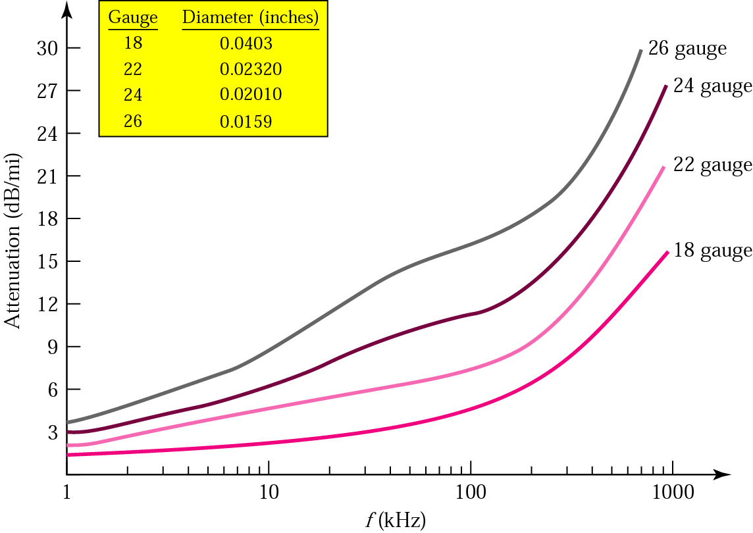
Twisted-Pair Cable

Slide 13

Coaxial Cable
Coaxial Cable
  carries signals of higher frequency ranges
Frequency range of coaxial cable

Slide 14

Coaxial Cable
Figure 7.7 Coaxial cable

Slide 15

Coaxial Cable
Coaxial Cable Standards
  ~ are categorized by RG(radio government) rating
Table 7.2 Categories of coaxial cables

Slide 16
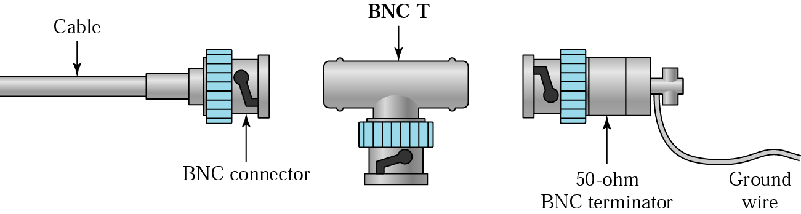
Coaxial Cable
Coaxial Cable Connectors

Slide 17
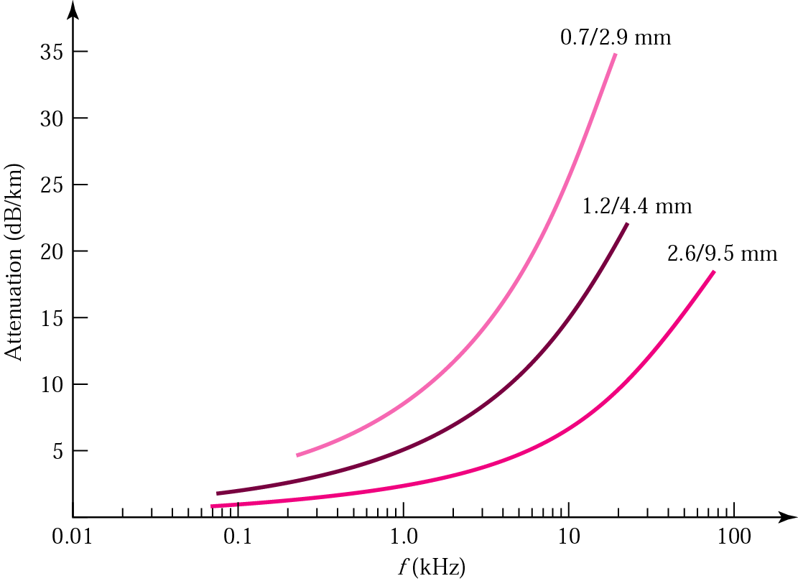
Coaxial Cable
Performance

Slide 18
Optical Fiber Cable
Optical Fiber
  ~ is made of glass or plastic and transmits signals in the form of light
Nature of Light
  ~ is a form of electromagnetic energy. It travels at its fastest in a vacuum : 300,000km/s. This speed decreases as the medium through which the light travels become denser.

Slide 19
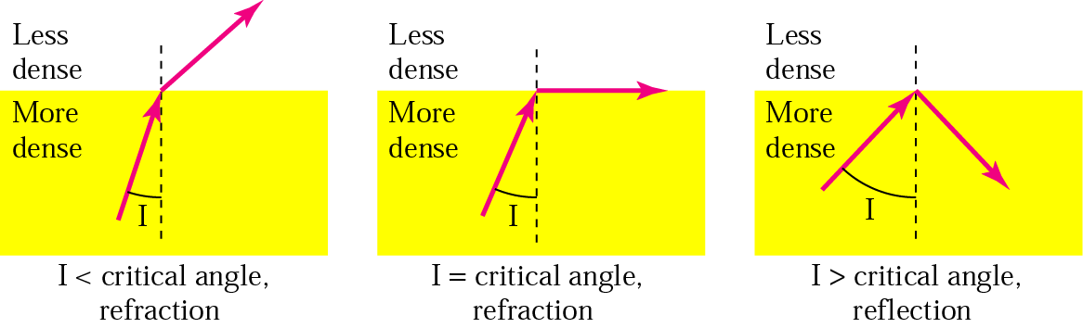
Optical Fiber Cable
Refraction

Slide 20
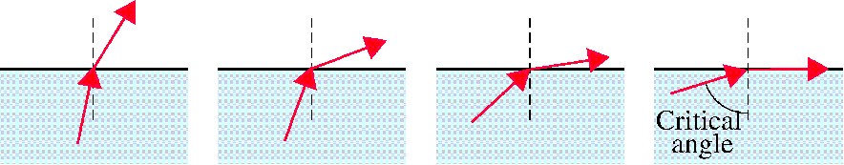
Optical Fiber Cable
critical angle
  As the angle of incidence increases, it moves away from vertical and closer to the horizontal.

Slide 21
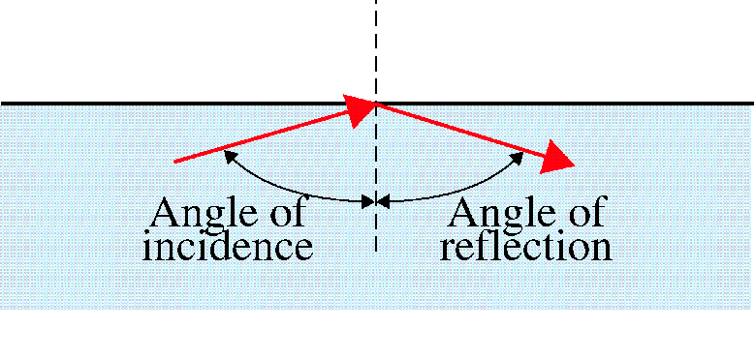
Optical Fiber Cable
Reflection
  When the angle of incidence becomes greater than the critical angle, a new phenomenon occurs called reflection

Slide 22

Optical Fiber Cable
Optical Fiber

Slide 23

Optical Fiber Cable
Propagation Models
  current technology supports two models for propagating light along optical channel.

Slide 24

Optical Fiber Cable
Figure 7.13 Modes

Slide 25
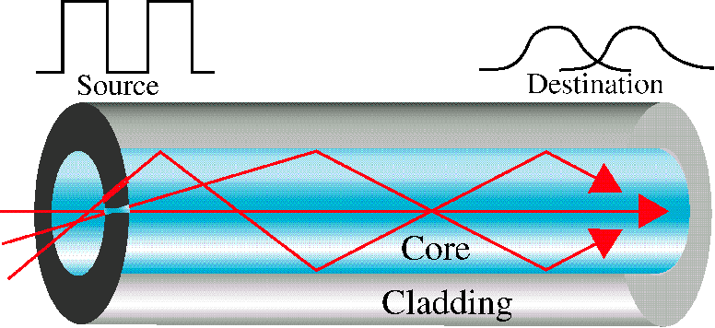
Optical Fiber Cable
Multimode step-index
  ~ multiple beams from a light source move through the core in different paths.

Slide 26
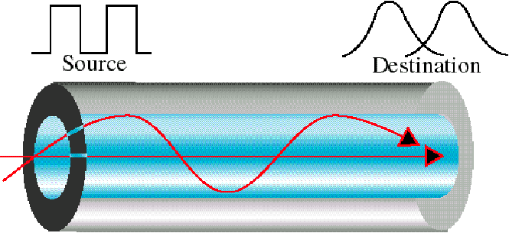
Optical Fiber Cable
Multimode graded-index
  fiber with varying densities
  highest density at the center of the core

Slide 27
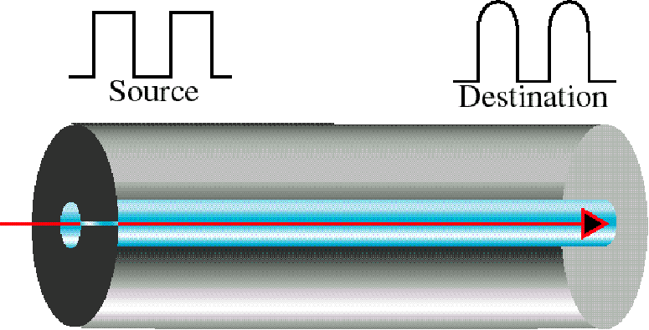
Optical Fiber Cable
Single Mode
  ~ uses step-index fiber and a highly focused source of light that limits beams to a small range of angles, all close to the horizontal.

Slide 28

Optical Fiber Cable
Fiber sizes
  ~ are defined by the ratio of the diameter of their core to the diameter of their cladding.
Table 7.3 Fiber types

Slide 29
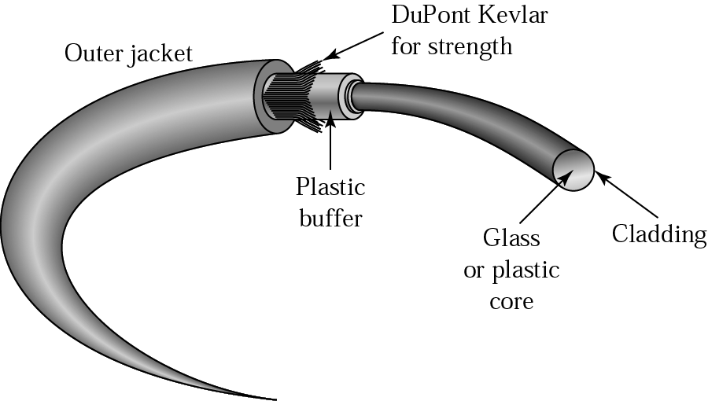
Optical Fiber Cable
Cable Composition

Slide 30
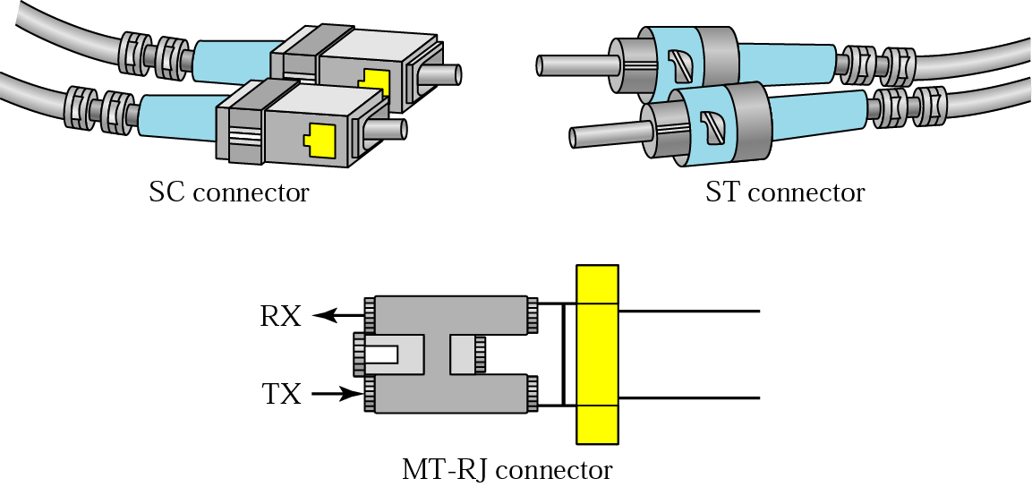
Optical Fiber Cable
Fiber-optic Cable Composition

Slide 31
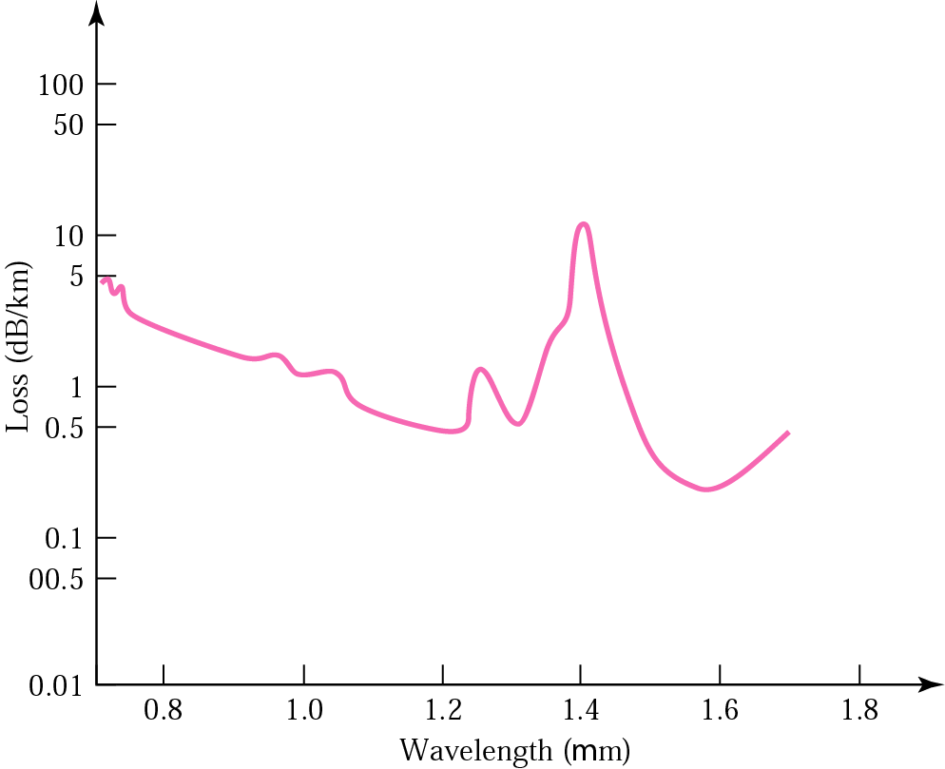
Optical Fiber Cable
Optical Fiber Performance
Wavelength (μm)

Slide 32
Optical Fiber Cable
Advantages of Optical Fiber
  Noise resistance
  Less signal attenuation
  Higher bandwidth
Disadvantages of Optical Fiber Cost
  Installation/maintenance
  Fragility

Slide 33
7.2 UNGUIDED MEDIA: WIRELESS
Unguided media transport electromagnetic waves without using a physical conductor. This type of communication is often referred to as wireless communication.
Topics discussed in this section:
Radio Waves
Microwaves
Infrared

Slide 34
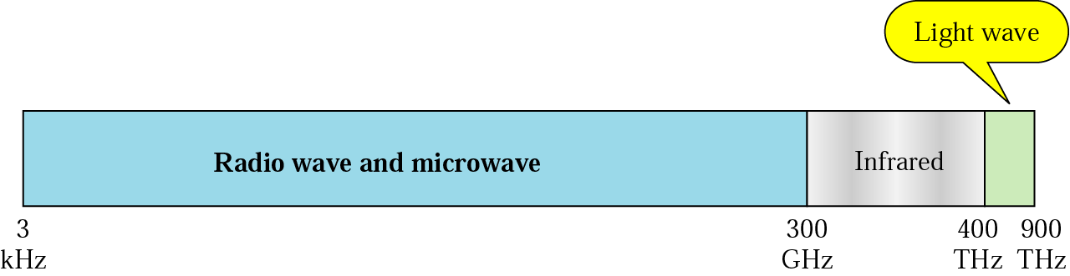
Unguided media
wireless
signals are broadcasted through air
Figure 7.17 Electromagnetic spectrum for wireless communication

Slide 35
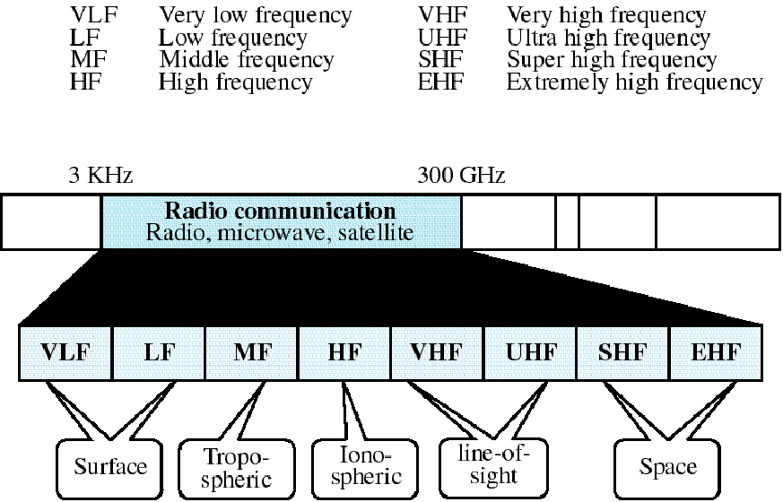
Wireless Transmission
Radio Frequency Allocation
대류층
전리층

Slide 36
Unguided media
Band | Range | Propagation | Application
VLF | 3–30 KHz | Ground | Long-range radio navigation
LF | 30–300 KHz | Ground | Radio beacons and navigational locators
MF | 300 KHz–3 MHz | Sky | AM radio
HF | 3–30 MHz | Sky | Citizens band (CB), ship/aircraft communication
VHF | 30–300 MHz | Sky and line-of-sight | VHF TV, FM radio
UHF | 300 MHz–3 GHz | Line-of-sight | UHF TV, cellular phones, paging, satellite
SHF | 3–30 GHz | Line-of-sight | Satellite communication
EHF | 30–300 GHz | Line-of-sight | Long-range radio navigation

Slide 37
Travel of Radio Wave
Ground Propagation
  traveling through the lowest portion of the atmosphere, hugging the earth
  Emanating in all directions from the transmitting antenna and following the curvature of the planet
Sky Propagation
  High-frequency radio waves radiate upward into the ionosphere
  Allowing for greater distances with lower output power
Line of sight Propagation
  Very high-frequency signals in straight lines
  Directional antenna

Slide 38
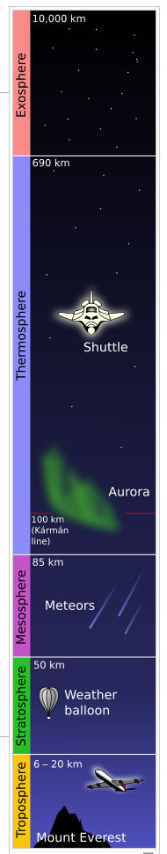
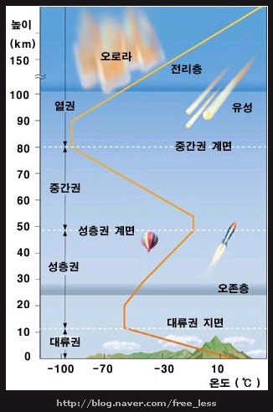
Earth’s Atmosphere
외기권
(ionosphere)
(meteor)
열권
중간권
성층권
대류권

Slide 39

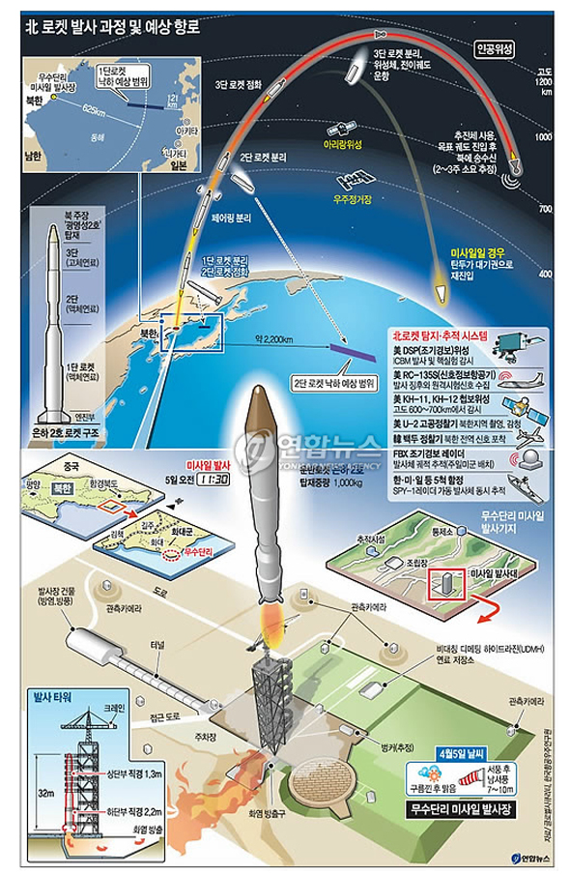
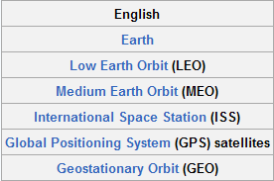
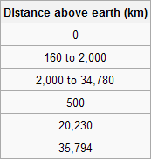
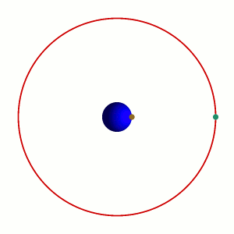
An Example: Satellite
Geostationary orbit
(geosynchronous orbit)

Slide 40

Wireless Transmission
Propagation of radio waves
  Types of propagation

Slide 41
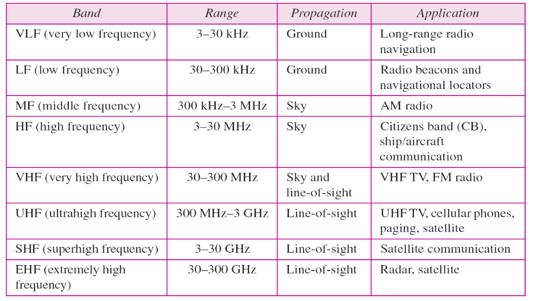
Wireless Transmission
Table 7.4 Bands

Slide 42
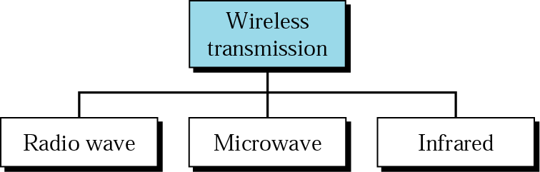
Wireless Transmission
Wireless Transmission Waves

Slide 43
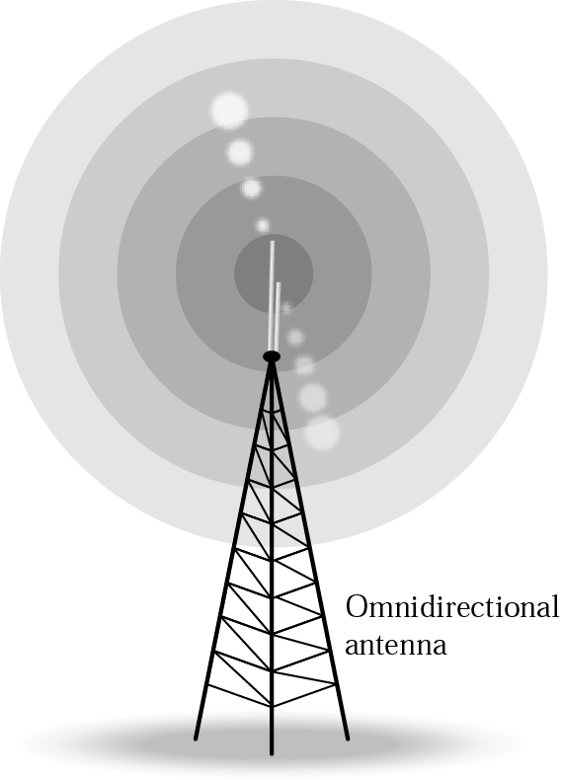
RADIO WAVE
Electromagnetic waves ranging in frequencies between 3khz and 1Ghz are called Radio wave.
Radio waves are Omni-directional, they are propagated in all directions.
Radio waves are propagated in sky mode, can travel long distance.

Slide 44

RADIO WAVE
Note
Radio waves are used for multicast communications, such as radio and television, and paging systems.

Slide 45
MICRO WAVES
Electromagnetic waves having frequencies between 1 and 300Ghz are called Microwaves.
Microwave propagation is line-of-sight. Since the towers with the mounted antennas need to be in direct sight of each other.
Very high-frequency M/W cannot penetrate walls.
The M/W band is relatively wide, almost 299 Ghz.
  Therefore wider subbands can be assigned, and a high data rate is possible.

Slide 46
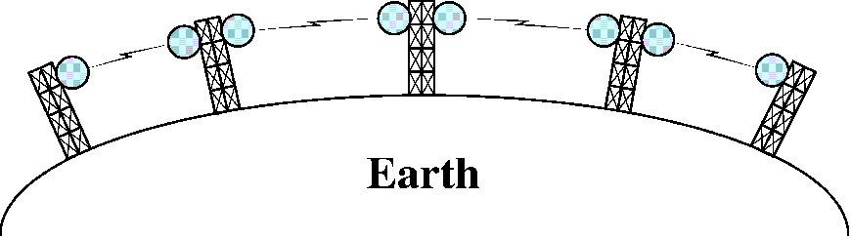
MICRO WAVE
Repeaters
  To increase the distance served by terrestrial microwave, a system of repeaters can be installed with each antenna.

Slide 47
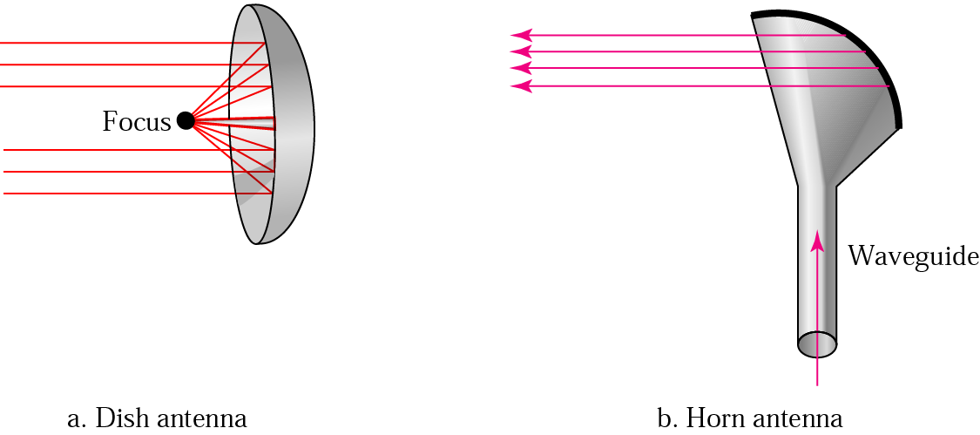
MICRO WAVE
Antenna – need unidirectional antenna that send out signals in one direction
  parabolic dish antenna
  horn antenna

Slide 48
MICRO WAVE
Microwaves are used for unicast communication such as cellular telephones, satellite networks,
and wireless LANs.

Slide 49
Infrared
Infrared waves, with frequencies from 300 Ghz to 400 Thz, can be used for short-range communication.
Infrared waves, having high frequencies, cannot penetrate walls.
  this advantageous characteristic prevents interference between one system and another; a short-range communication system in one room cannot be affected by another system in the next room.
We cannot use infrared waves outside a building because the sun’s rays contain infrared waves that can interfere with the communication

Slide 50
Infrared
Infrared signals can be used for short-range communication in a closed area using line-of-sight propagation.

Slide 51
Summary (1)
Transmission media lie below the physical layer.
A guided medium provides a physical conduit from one device to another. Twisted-pair cable, coaxial cable, and optical fiber are the most popular types of guided media.
Twisted-pair cable consists of two insulated copper wires twisted together. Twisted-pair cable is used for voice and data communication.
Coaxial cable consists of a central conductor and a shield. Coaxial cable can carry signals of higher frequency ranges than twisted-pair cable. Coaxial cable is used in cable TV networks and traditional Ethernet LANs

Slide 52
Summary (2)
Fiber-optic cables are composed of a glass or plastic inner core surrounded by cladding, all encased in an outside jacket.
Unguided media (free space) transport electromagnetic waves without the use of a physical conductor.
Wireless data are transmitted through ground propagation, sky propagation, and line-of-sight propagation. Wireless waves can be classified as radio waves, microwaves, or infrared waves. Radio waves are omnidirectional; microwaves are unidirectional. Microwaves are used for cellular phone, satellite, and wireless LAN communications.
Infrared waves are used for short-range communications such as those between a PC and a peripheral device. It can also be used for indoor LANs.

Slide 53

Q & A

